Slide 1


Slide 2
Harvesting New Fruit
Thursday May 6
Catholic Education Week 2021

Slide 3
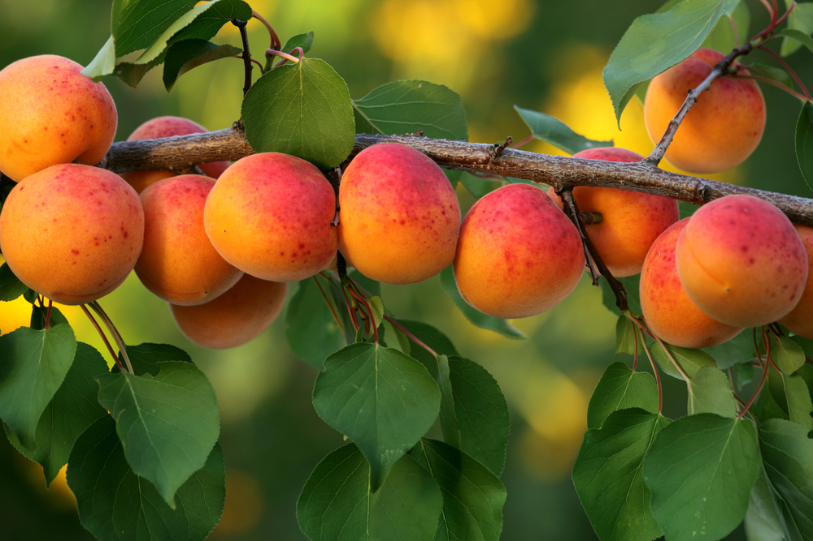

Slide 4
Harvesting New Fruit
Welcome to fourth day of Catholic Education week. It is so good to gather and pray together. Today’s theme is harvesting new fruit. Once the seeds, the sun and the rain have worked together there is fruit and/or vegetables to harvest. In our lives there is new fruit in the skills that we learn and the potentials that are developed. These new fruit bless us abundantly.
In the name of the Father and of the Son and of the Holy Spirit. Amen.

Slide 5
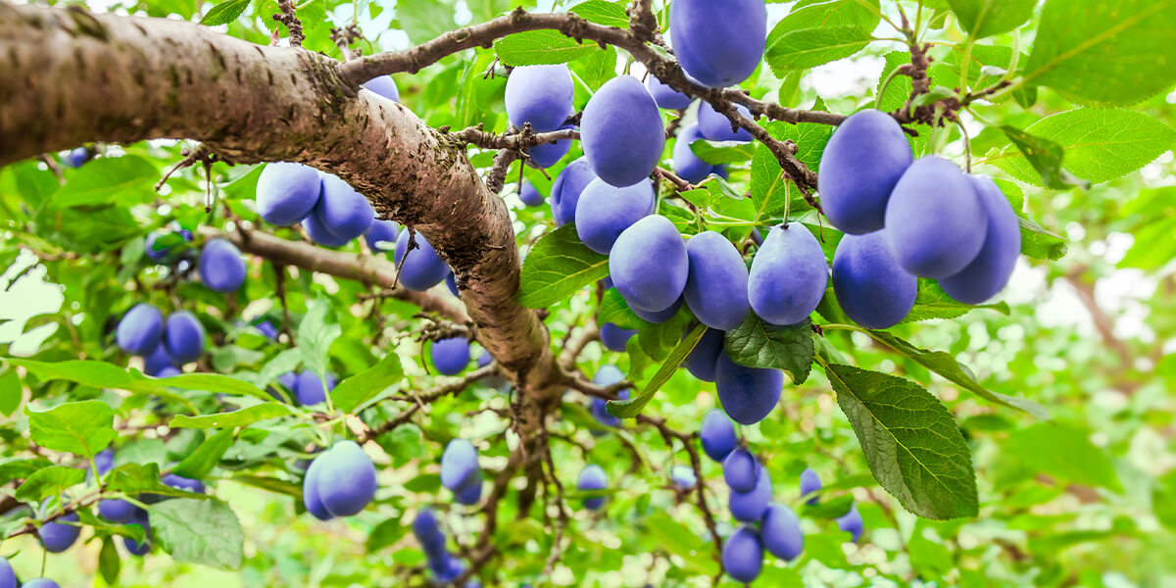

Slide 6
Prayer for the Work of Our Hands
Blessed are you, Lord God, Creator of all that is good,
for in your mercy you give us work that we may be co-creators with you.
With hands to fashion and form, minds to imagine what has yet to be, hearts to care what we have made, and a spirit to impart to our own creations, we rejoice in the labour you give us.

Slide 7
By imitating you, our God and Maker, we continue to shape the world, to name it and claim it and be good stewards of your good gifts through the life-giving Spirit that renews the earth.
Keep us mindful of the power you share with us that we may create only that which leads to peace. May the work of our hands and our vision and dreams collaborate with your good will, which continues to build for us your kingdom on earth.
We ask this through Christ our Lord. Amen+

Slide 8
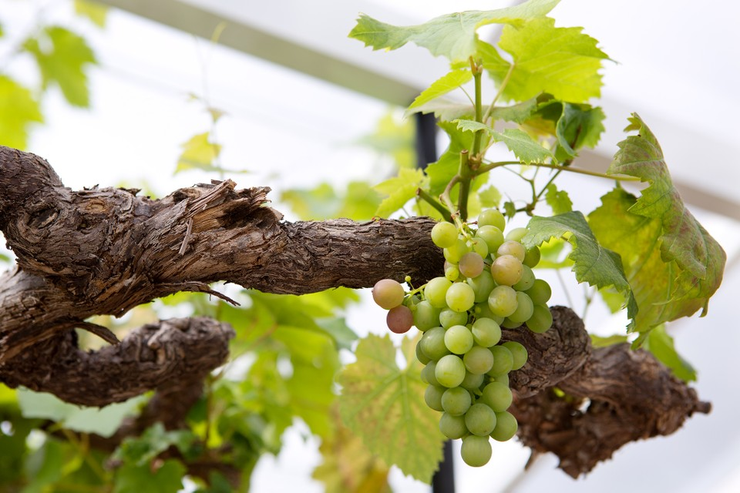

Slide 9
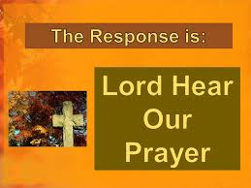
Prayer of the Faithful
Let us pray for our Holy Father Francis who is remind us to live out our baptism in being holy.
We pray.
Let us pray for all of our families who want us good things for us and for us to be the best we can be.
We pray.

Slide 10
Let us pray for all mental health workers and counsellors who are supporting those who struggle.
We pray
Let us pray for all the sick and for all who care for them. We pray.
Let us pray for all those who have died and the families that are grieving. We pray.

Slide 11
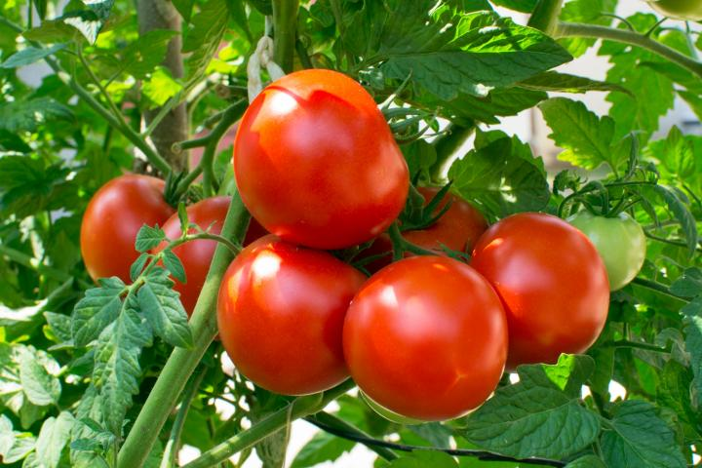

Slide 12
CEW Song with video lyrics
https://www.youtube.com/watch?v=U5PZzF72mY8
In the name of the Father and of the Son and of the Holy Spirit. Amen+

