Slide 1


Slide 2
Cultivating Relationships
Wednesday May 5
Catholic Education Week 2021

Slide 3
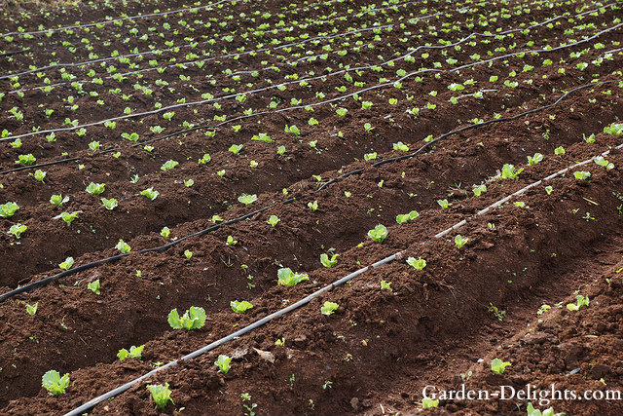

Slide 4
Cultivating Relationships
Welcome to third day of Catholic Education week. It is so good to gather and pray together. Today’s theme is cultivating relationships. Once we have planted a garden we need to ensure it receives all the things that will help it to grow. We need to do the same with the relationships in our lives. We need to make sure our relationships are cared for too.
In the name of the Father and of the Son and of the Holy Spirit. Amen.

Slide 5
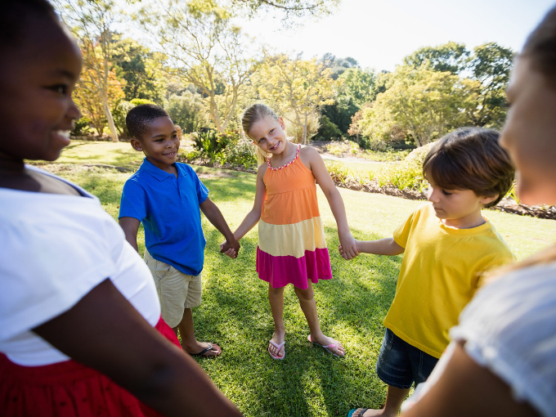

Slide 6
Shower the People https://www.youtube.com/watch?v=6cqNPySNyDM
You can play the game and you can act out the part, even though it wasn’t written for you. Tell me, how can stand there with your broken heart ashamed of playing the fool. One thing can lead to another; it doesn’t take any sacrifice. Oh, father and mother, sister and brother, if it feels nice don’t think twice.
Just shower the people you love with love, show them the way that you feel. Things are gonna to work out fine, if you only will do as I say.
Just shower the people you love with love, show them the way that you feel. Things are gonna be much better if you only will.

Slide 7
You can run but you cannot hide, this is widely known. Tell me, what you plan to do with your foolish pride when you’re all by yourself, alone. Once you tell somebody the way that you feel, you can feel it beginning to ease. I think it’s true what they say about the squeaky wheel always getting the grease.
Better to shower the people you love with love, show them the way that you feel. Things are gonna to be just fine if you only will what I’d like to do to you.
Just shower the people you love with love, show them the way that you feel. Things are gonna be much better if you only will.

Slide 8
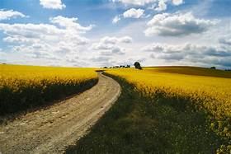
Shower the people you love with love, show them the way that you feel. You’ll feel better right away.
Don’t take much to do, sell your pride.
They say in every life, they say the rain must fall, just like pouring rain, make it rain. Make it rain, love, love, love is sunshine, oh yes,
Make it rain love, love, love is sunshine. Everybody, everybody.

Slide 9
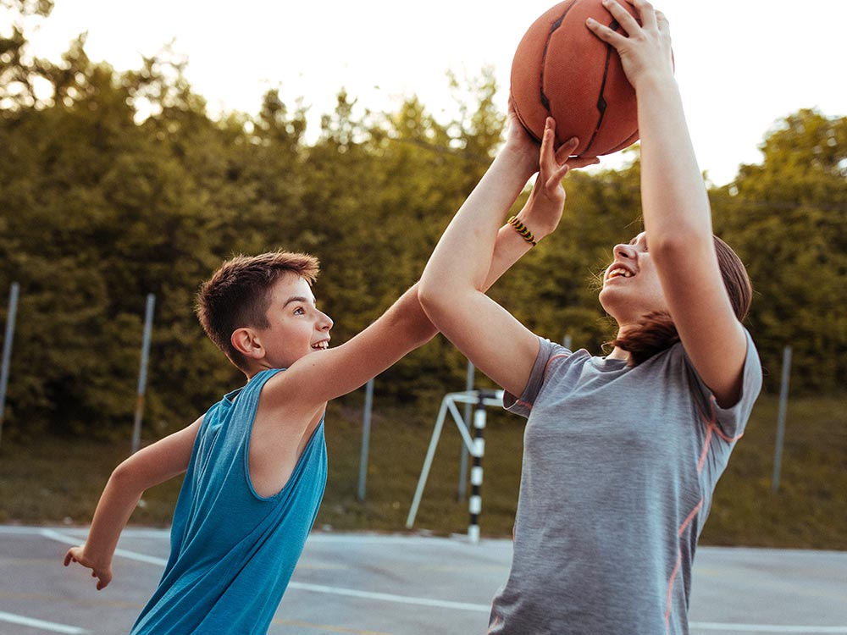

Slide 10
Make ME a Channel of your Peace.
Make me a channel of your peace. Where there is hatred, let me bring your love. Where there is injury, your pardon, Lord, and where there’s doubt, true faith in you.
Make me a channel of your peace. Where there’s despair in life, let me bring hope. Where they is darkness, only light, and where there’s sadness ever joy.
O Divine Master, grant that I may never seek so much to be consoled, as to console, to be understood, as to understand, to be loved, as to love, with all my soul.

Slide 11
Make me a channel of your peace. It is in pardoning that we are pardoned, in giving of ourselves that we receive, and in dying that we’re born to eternal life.

Slide 12


Slide 13

Prayer of the Faithful
Let us pray for our Holy Father Francis who is trying to help us to love all people as our brothers and sisters.
We pray.
Let us pray for all of the essential workers who continue to serve us faithful through the pandemic.
We pray.

Slide 14
Let us pray for all the scientists who continue to work on vaccines that will help us to well.
We pray
Let us pray for all the sick and for all who care for them. We pray.
Let us pray for all those who have died and the families that are grieving. We pray.

Slide 15
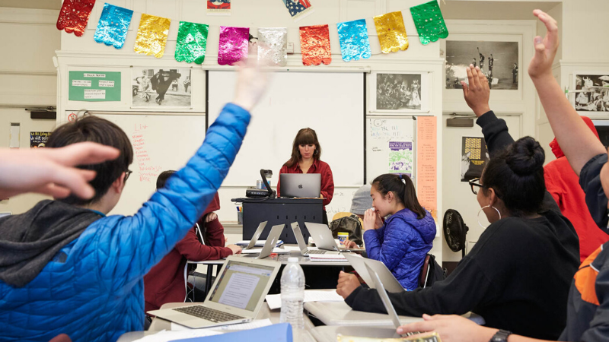

Slide 16
CEW Song with video lyrics
https://www.youtube.com/watch?v=U5PZzF72mY8
In the name of the Father and of the Son and of the Holy Spirit. Amen+

