Slide 1


Slide 2
Sowing Seeds of Gratitude
Tuesday May 4
Catholic Education Week 2021

Slide 3
Sowing seeds of gratitude
Welcome to second day of Catholic Education week. It is so good to gather and pray together. Today’s theme is sowing seeds of gratitude. Once we have prepared the earth for planting, we select which seeds we will sow. This year we will sow seeds of gratitude.
In the name of the Father and of the Son and of the Holy Spirit. Amen.

Slide 4
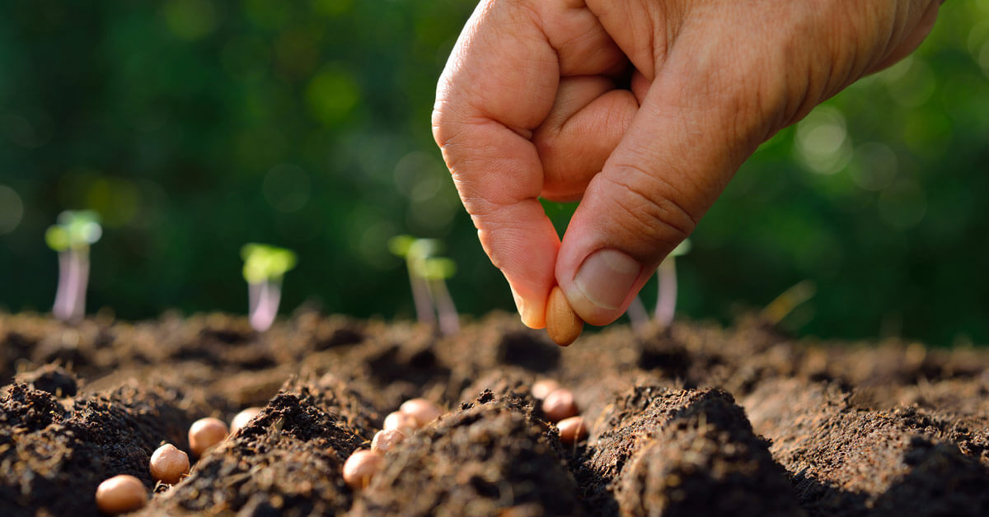

Slide 5
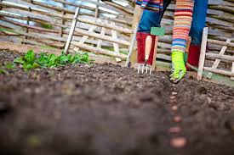
A prayer for the care of the earth
God our Father and Creator, we give you thanks for the wonder of creation which inspires us,
the fruit of the Earth which feeds us,
the beauty of nature which grounds us,
the joy of life which gives us hope.
Heal the places where your creation has been marred,
and restore all creatures to the splendor of your glory,
that all may delight once again in your goodness.
We ask this through Christ our Lord. Amen.

Slide 6
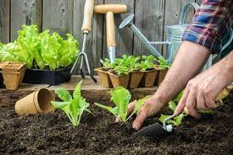

Slide 7
Inch by Inch - https://www.youtube.com/watch?v=y1oiVEWFHrs
Refrain
Inch by inch, row by row,
gonna make this garden grow, all it takes is a rake and a hoe and a piece of fertile ground.
Inch by inch, row by row, someone bless these seeds I sow, someone warm them from below, ‘til the rain comes tumbling down.
Pulling weeds and picking stones, we are made of dreams and bones, feel the need to grow my own, ‘cause the time is close at hand.
Grain for grain, sun and rain, find my way in nature’s chain, tune my body and my brain to the music of the land.

Slide 8
Plant your rows straight and long, temper them with prayer and song, Mother Earth will make you strong if you give her love and care.
Old crow watching hungrily, from his perch in yonder tree, in my garden I am free as that feathered thief up there.
Inch by inch, row by row, gonna make this garden grow, all it takes is a rake and a hoe and a piece of fertile ground.
Inch by inch, row by row, someone bless these seeds I sow someone warm them from below ‘til the rain comes tumbling down.

Slide 9
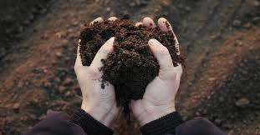

Slide 10

Prayer of the Faithful
Let us pray for our Holy Father Francis who is trying to help us to fall in love with the earth.
We pray.
Let us pray for all of our farmers who are sowing seeds for the food that we will eat.
We pray.

Slide 11
Let us pray for migrant farmworkers who come from other countries to plant and pick food for us to eat. We pray.
Let us pray for all the sick and for all who care for them. We pray.
Let us pray for all those who have died and the families that are grieving. We pray.

Slide 12
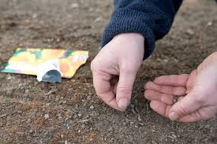

Slide 13
CEW Song with video lyrics
https://www.youtube.com/watch?v=U5PZzF72mY8
In the name of the Father and of the Son and of the Holy Spirit. Amen+

