Slide 1


Slide 2
Preparing the Earth
Monday May 3
Catholic Education Week 2021

Slide 3


Slide 4
Preparing the earth of our lives
Welcome to Catholic Education Week 2021. It is so good to gather and pray together. Today’s theme is preparing the earth of our lives. When we plant a garden, we have to remove all the stones and stuff in the earth that will stop new growth. We need to do this in our lives as well.
In the name of the Father and of the Son and of the Holy Spirit. Amen.

Slide 5
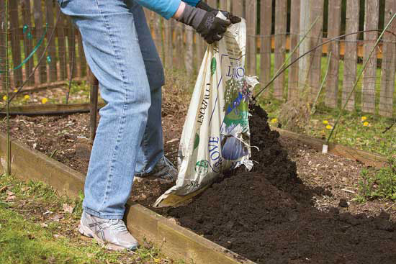

Slide 6
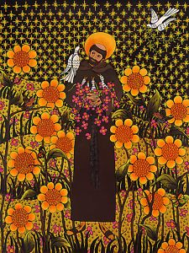
A reading from a letter by Pope Francis
St. Francis helps us to see that an integral ecology calls for openness ...
and take us to the heart of what it is to be human.
Just as happens when we fall in love with someone,
whenever Francis would gaze at the sun, the moon or the smallest of animals, he burst into song, drawing all other creatures into his praise.
He communed with all creation, even preaching to the flowers, inviting them “to praise the Lord.” LS 11

Slide 7
Canticle of the Sun
Refrain
The heavens are telling the glory of God, and all creation is shouting for joy.
Come, dance in the forest, come, play in the field,
And sing, sing to the glory of the Lord.
Praise for the sun, the bringer of day, he carries the light of the Lord in his rays; The moon and the star who light up the way unto your throne. R.
Praise for the wind that blows through the trees, the seas’ mighty storms, the gentlest breeze; they blow where they will, they blow where they please to please the Lord. R.

Slide 8
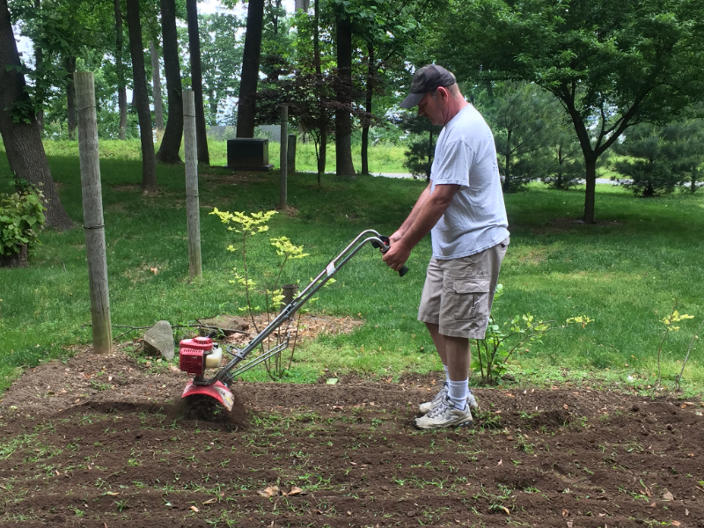

Slide 9

Prayer of the Faithful
Let us pray for our Holy Father Francis, our bishop Thomas, our pastor, and all who serve God’s people. We pray.
Let us pray for our Catholic learning community, for all who serve us everyday. We pray.

Slide 10
Let us pray for all the sick and for all who care for them. We pray.
Let us pray for all those who have died and the families that are grieving. We pray.
Let us pray for the Earth that we will be good stewards of our planet home. We pray.

Slide 11
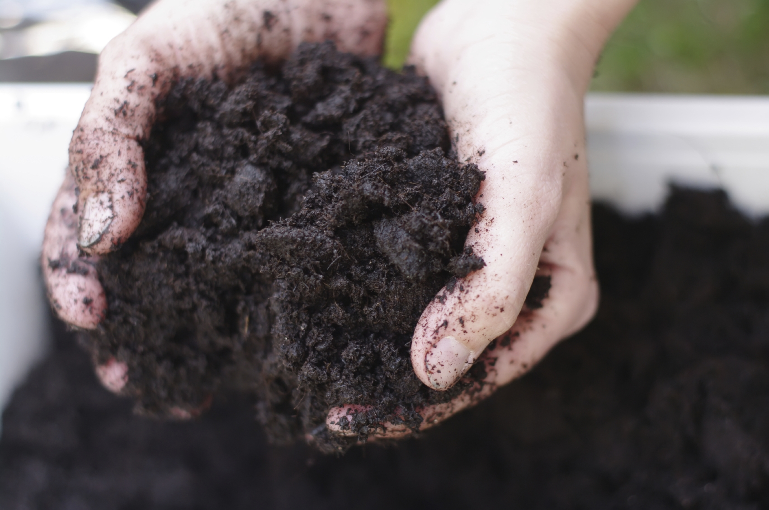

Slide 12
CEW Song with video lyrics
https://www.youtube.com/watch?v=U5PZzF72mY8
In the name of the Father and of the Son and of the Holy Spirit. Amen

